Slide 1

Using Regression Analysis to Predict Happiness Scores of a Country
Group 7
Yinuo Sun, Meagan Rathjen, Chenghan Ying & Haoran Zhang

Slide 2


Introduction
BACKGROUND & IMPORTANCE
United Nations
New standard to measure development
quantity -> quantity + quality
More comprehensive than GDP
Measure social progress
See change through time
Inform policy
Notes:
Even if GDP increases, people’s satisfacation in life does not increase. https://news.gallup.com/opinion/gallup/206468/happiest-unhappiest-countries-world.aspx

Slide 3
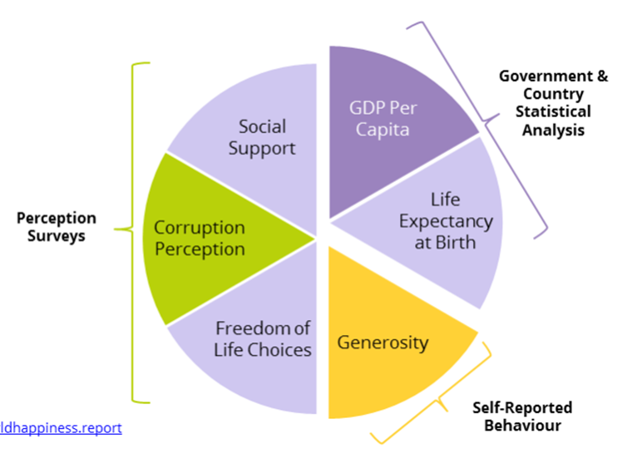
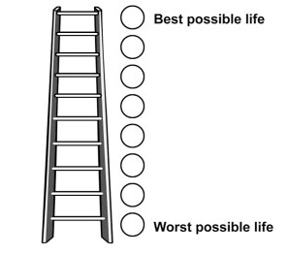
Introduction
WHR PROCESS & VARIABLES
1,000 people / year x 3 years => 3,000 people on average/country
Synthesized across 2014-2016
155 countries
Happiness Score = Cantril ladder measures life satisfaction
from the Gallup World Poll
6 Variables help understand
Notes:
Cantril ladder, which is standard in social science, to have people choose on a scale of 0 to 10 where they rate their lives (Helliwell et al. 2017).
answers are synthesized across three years, 2014-2016 in this case, and the countries are ranked by their correlated happiness levels

Slide 4
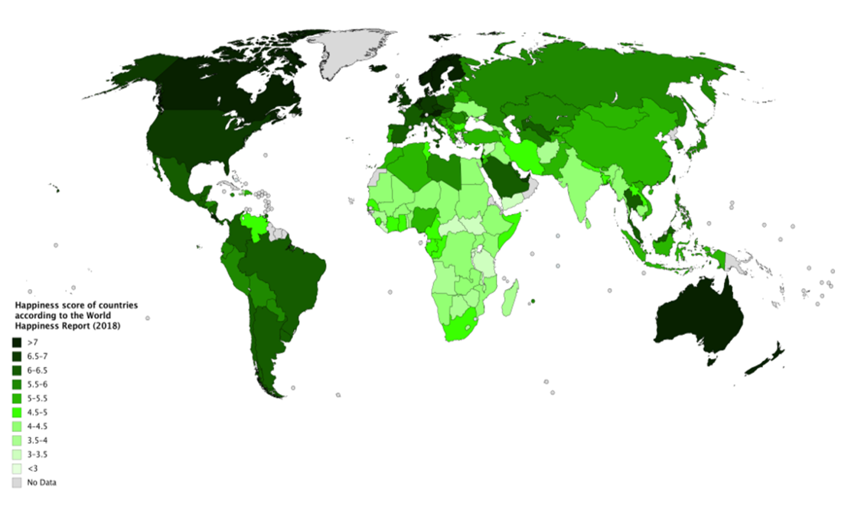
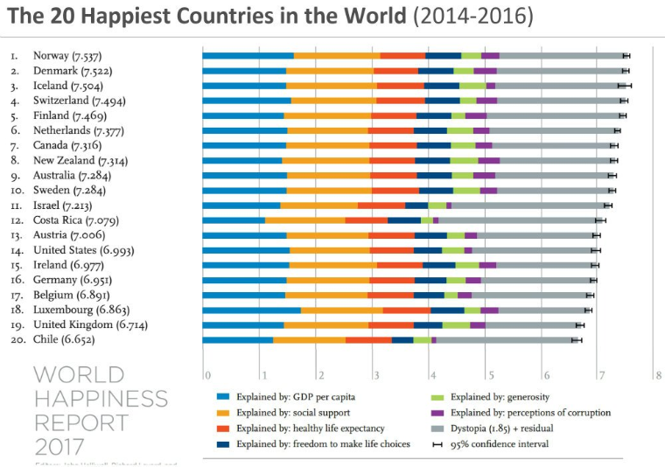
Introduction
Happiness scores around the world
Variables help explain score
Standard development measurement (GDP)
Notes:
Using the data from the 2017 WHR, we will look at the relationship between the each of the six key variables and the happiness score from each country, as well as, the relationship between each pair of two key variables

Slide 5
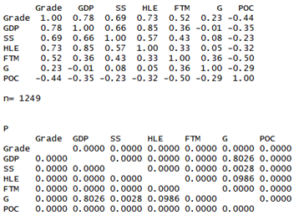
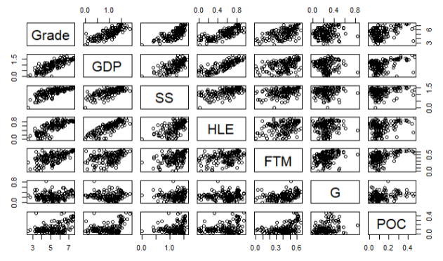
Methods
Primary analyses: Is it appropriate to use linear regression model?
the relationship between response variables and predictor variables
collinearity issue
Scatterplot
Correlation matrix

Slide 6
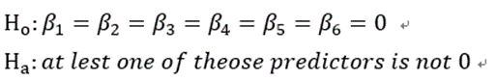
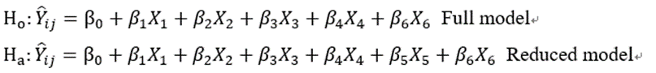

Methods
We found correlation：
First Try: standardization $new X_{i}=\frac{X_{i}−μ}{s}$
Second Try: WLS
Model selection:
i) Use MLR and check linear relationships using F test iii) Bestsub methods and best model
ii) Dropping some variables if possible iv) Check assumptions (residuals, shapiro, BF test, and qq plot)

Slide 7
Methods
3. Diagnostic
i) Check if there exists any outliers
ii) Use Cook’s Distance and DFBETAS to test these outliers have major influence
iii) Employ VIF to check multicollinearity
4. Remedy Methods
i) Robust regression for influencial cases
ii) Ridge regression for multicollinearity

Slide 8
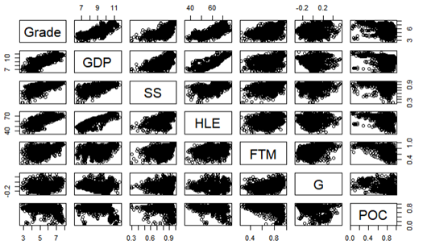
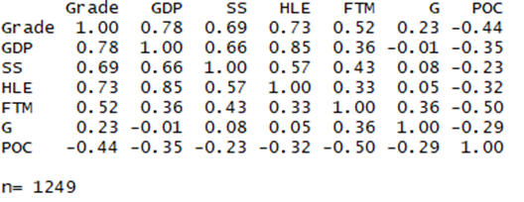
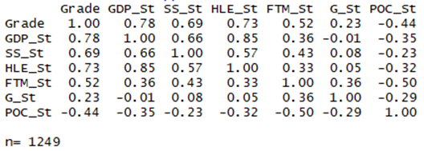
Result - Primary Analysis
There are correlations between GDP and SS and between GDP and HLE.
Correlation Matrix
Correlation Matrix (Standardization)
Scatter plot of the full model

Slide 9
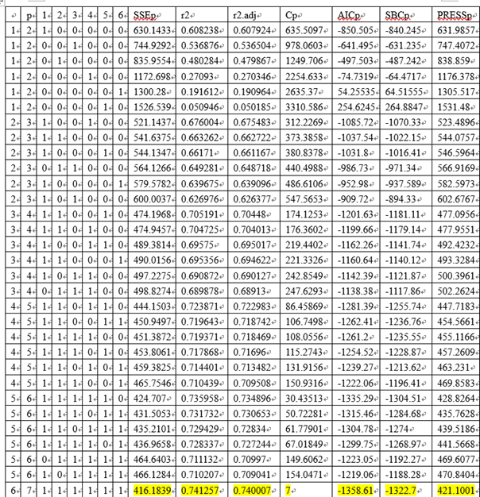
Result
Best-subsets model selection

Slide 10
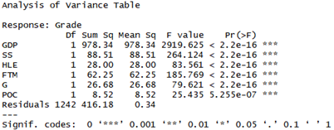
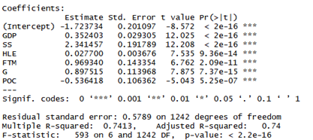
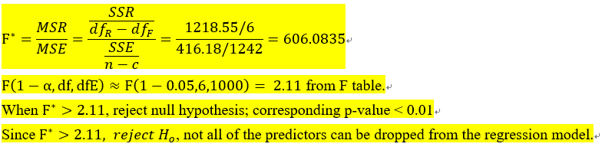
Result
All the parameters are significant according to the F test and P-value.
Parameter estimates table for primary full model.

Slide 11
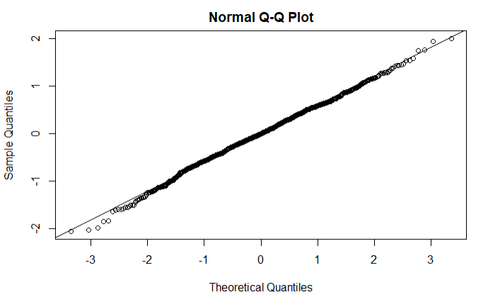
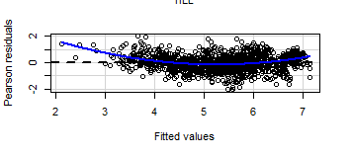
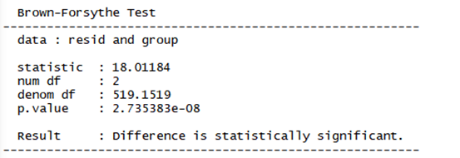
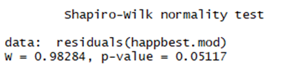
Result
Checking assumptions

Slide 12
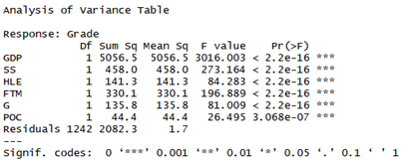
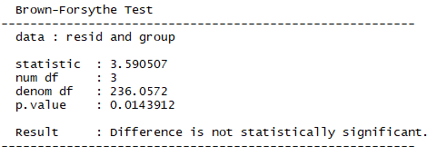
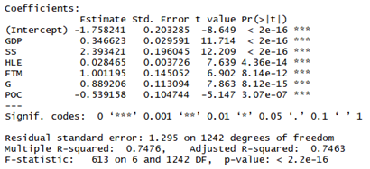
Result - WLS Final Model
BF test results are somewhat improved

Slide 13
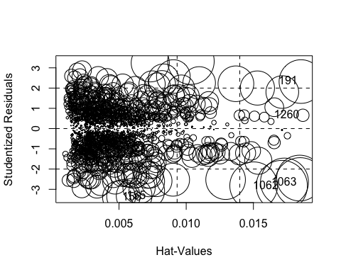
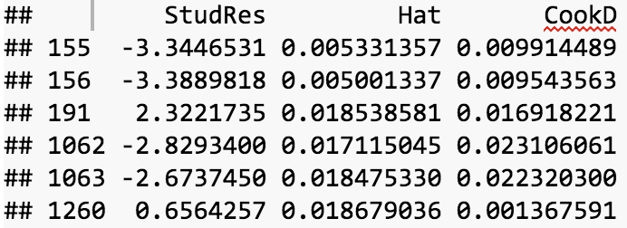
Diagnostics
Test for Y outliers with Stuentized residual:
Fig. Diagnostic plot
Conclusion: no Y outliers exist

Slide 14
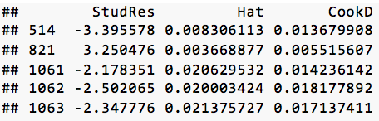
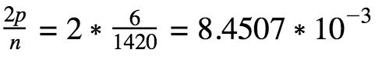
Diagnostics
Test for X outliers with hat matrix leverage values:
Conclusion:
3 cases are considered outlying (#1061, #1062, #1063)
Fig. Diagnostic plot

Slide 15
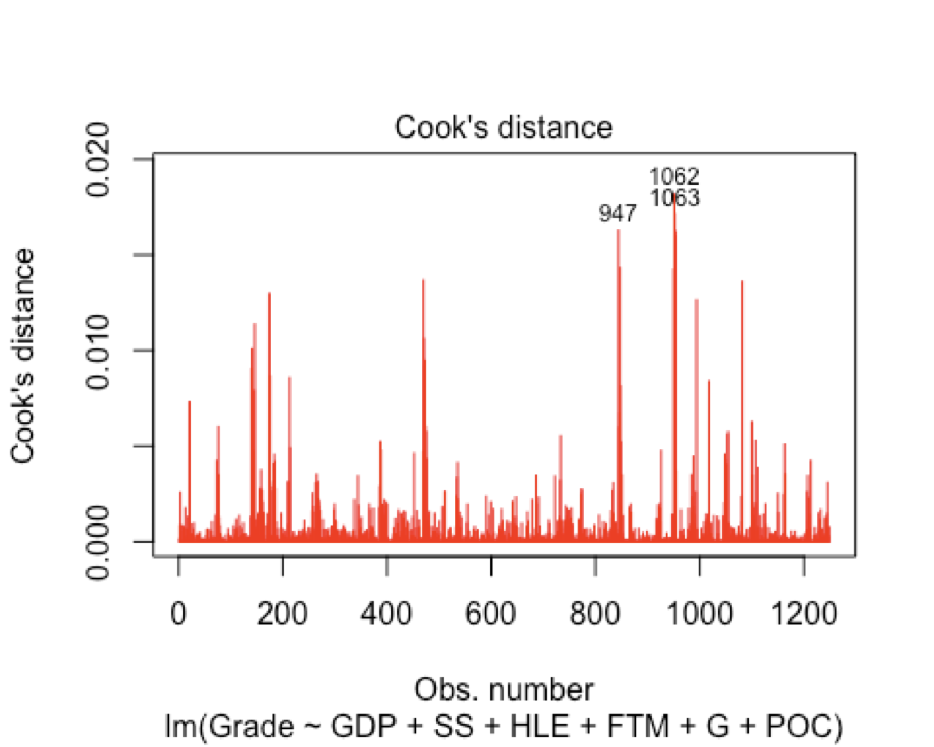
Diagnostics
F(0.2;6,1414)=0.5458189
F(0.5;6;1414)=0.9069763
All Cases have little influence
on the fitted value

Slide 16
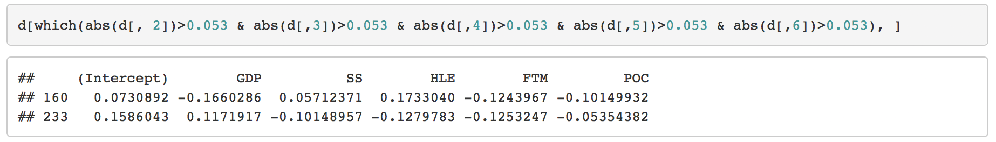
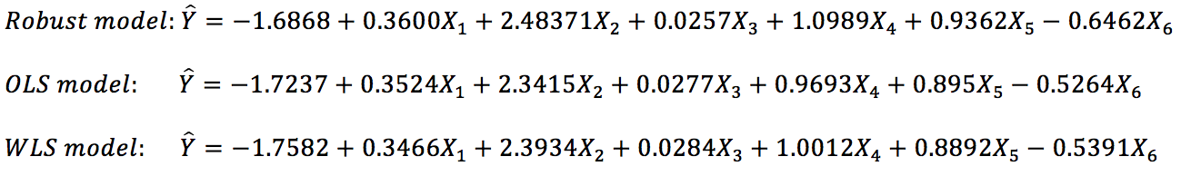
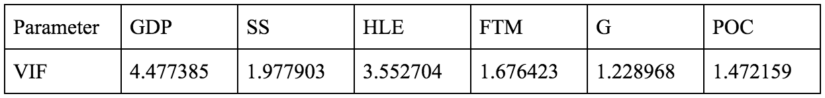
Diagnostics
DFBETAS
Robust regression
VIF: no multicollinearity

Slide 17
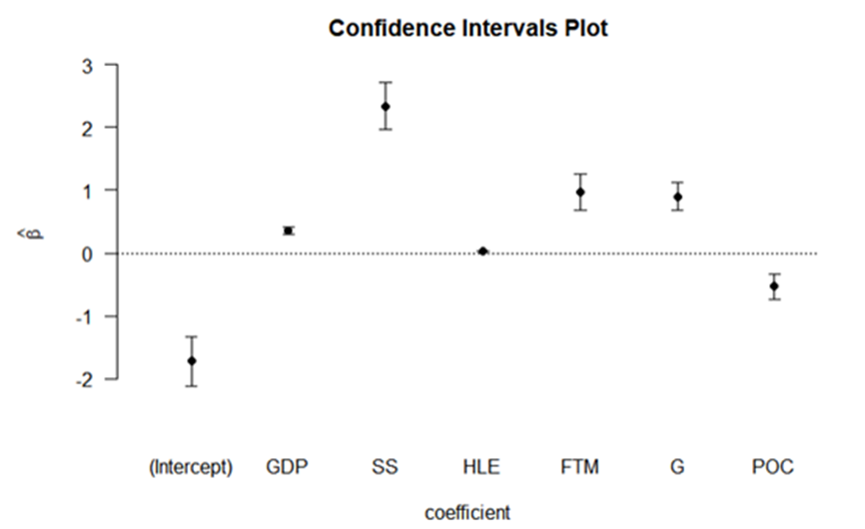
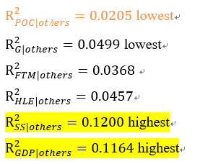
Discussion: Interpretation
GDP and Social support are most influential factors
Confidence intervals for GDP and SS are lowest, therefore have less variation and are more reliable
other variables are less reliable

Slide 18
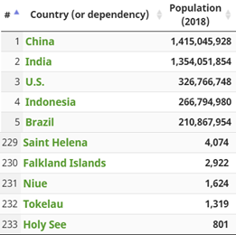
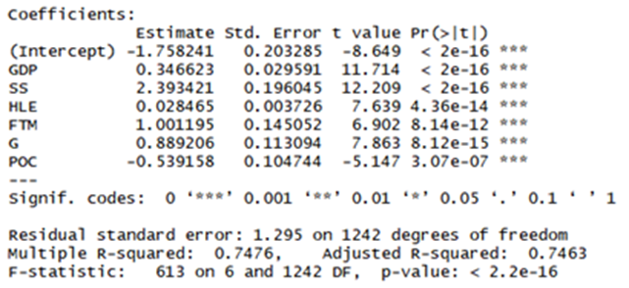
Discussion: Relevance
Relevance
Only 75% of the response variable variation is explained by the linear model
Survey-based data could be unreliable
Linear model may be inappropriate for some variables

Slide 19
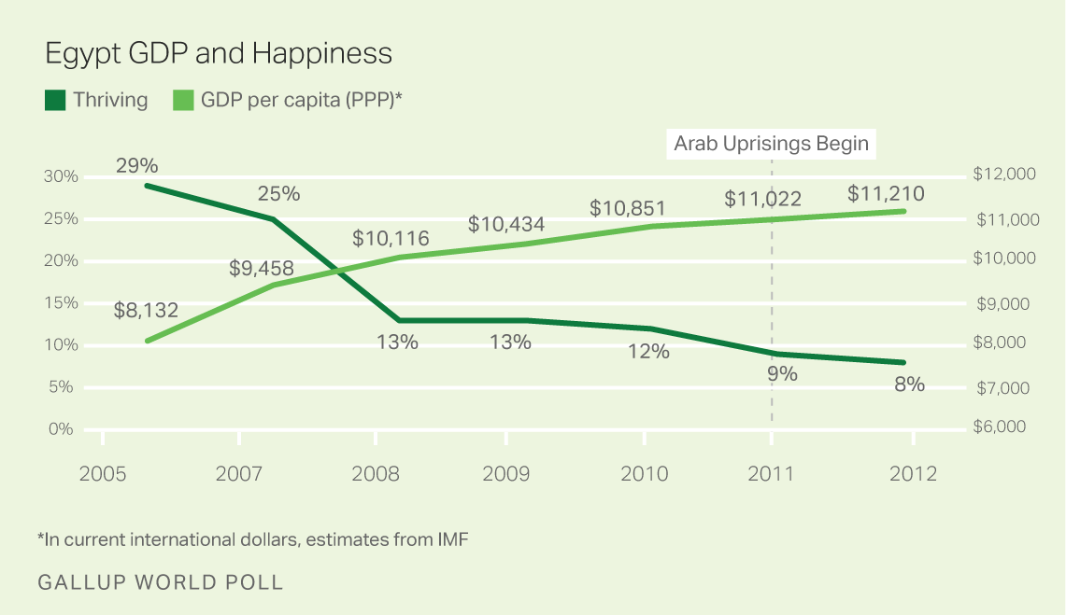
Discussion: Limitations
Limitation to the dataset:
Improved with more variables
eg. Egypt, Arab Spring
Happiness is an individual experience, not national
Can happiness and values be measured quantitatively?
Limitation to the model:
1st order model vs 2nd order model
About 1/7 data is missing, which can influence results
Correlation cannot be stopped by standardization and WLS method

Slide 20
Thanks

